Slide 1
Accommodate Training
for Faculty
How to view Testing Room
Bookings and Approve

Slide 2
Testing
You will receive 2 Automated emails from Accommodate when the student books a testing request
A 3 day reminder email
A 1 day reminder Link will be provided to approve and upload the exam
In all emails, there will be a link provided to approve the request (recommended), upload the exam and write specifics instructions for administering the exams (i.e. formula sheet, type of calculator)

Slide 3
Testing: Uploading Exams 1. Login into Accommodate: https://access.mercer.edu

Slide 4
Testing
Uploading the exam any/or providing administration directions

Slide 5
Testing: Uploading/Administration information for the exam
Two ways to provide the test
Individual Student Test
1. Select "Courses" tab
2. Select Course
3. View "Room Bookings" –to see scheduled exam, approve exam and attach an exam.
You now have two views Pending and Approved - Room Bookings to help navigate
Exam Upload
If you have multiple students and only have one version of the test.
1. Select "Courses" tab
2. Select the Course needing an exam
3. Select "Exam" and "Add New Exam" - fill in the form and add attachment
New addition - you can select to use the same test for all students with reservations
“Apply to all records”

Slide 6
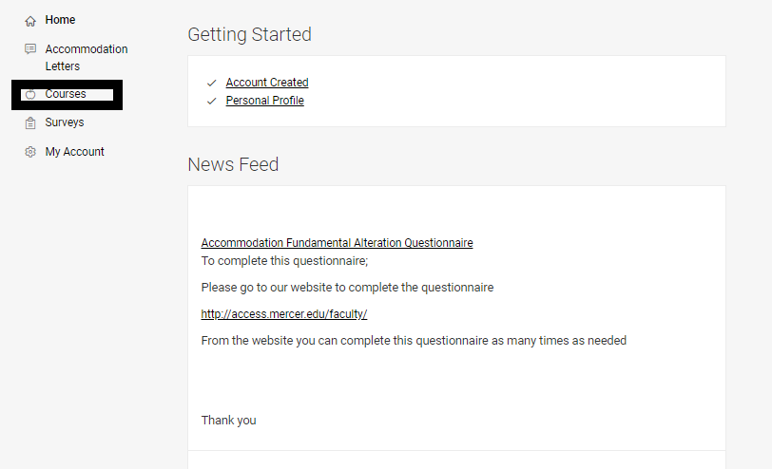
Testing: Attach exam to the student 1. Select the Courses Tab

Slide 7
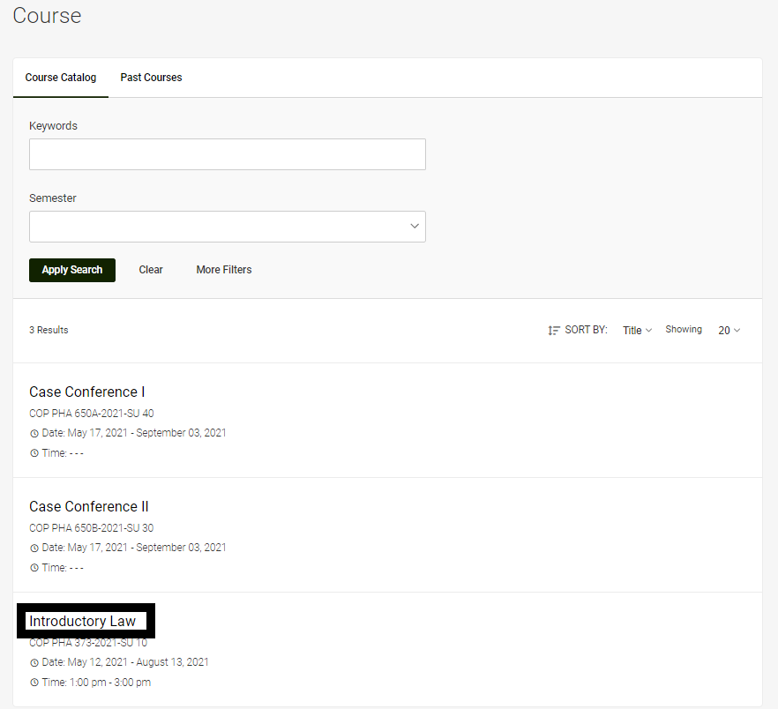
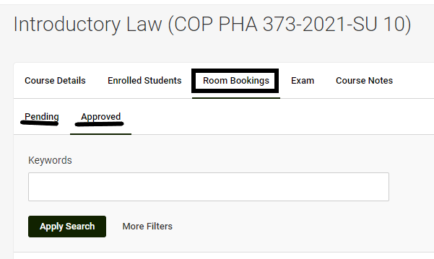
Testing: Attach exam to the student
2. Select Course
3. View Room Bookings
Pending or Approved

Slide 8
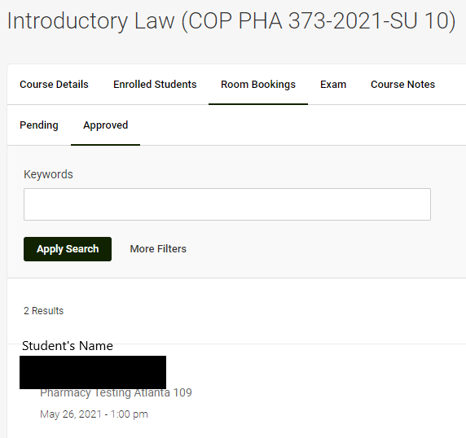
Testing: Attach exam to the student 4. Select the student’s name

Slide 9
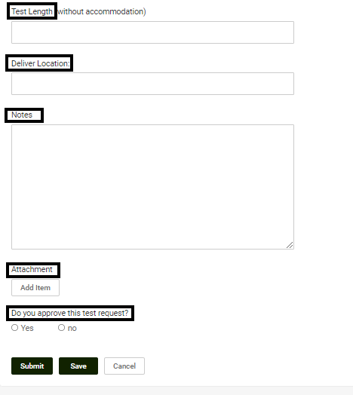
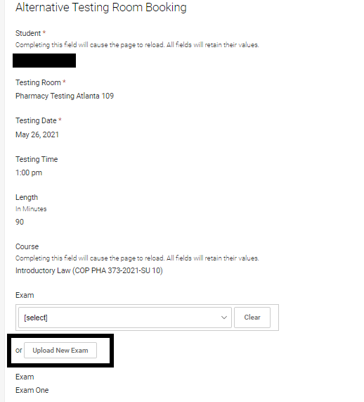
Testing: Attach exam to the student 5. Fill in the details and Save
View Scheduled Exam
Upload Exam
Test Length
Delivery Location
Notes
Approve/Deny

Slide 10
Testing
Uploading the exam to the Course

Slide 11
Testing: Upload the exam to the Course 1. Select Course

Slide 12
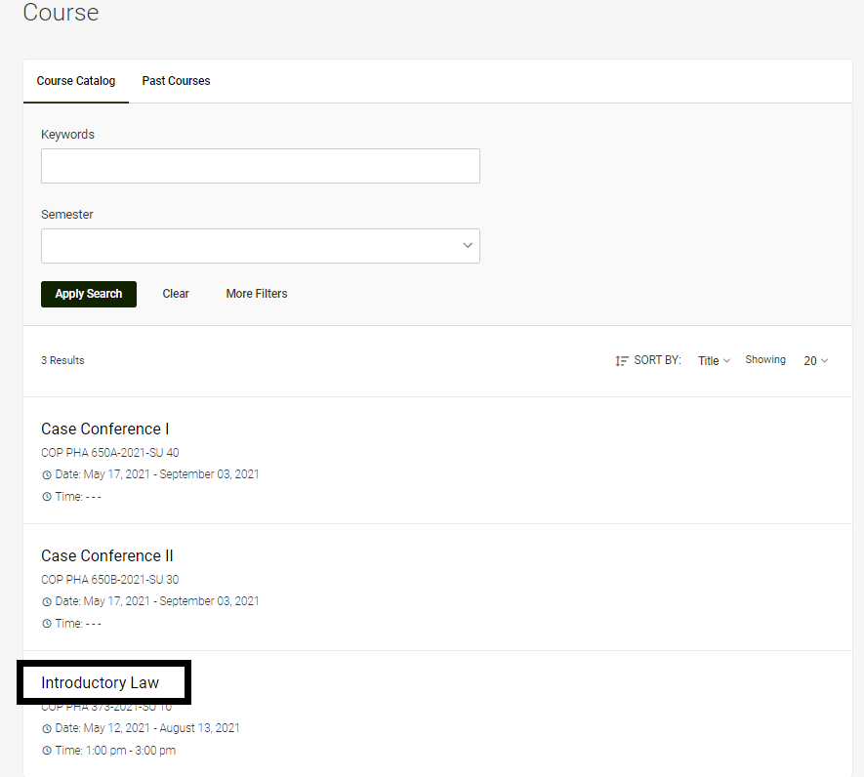
Testing: Upload the exam to the Course 2. Select the Course

Slide 13
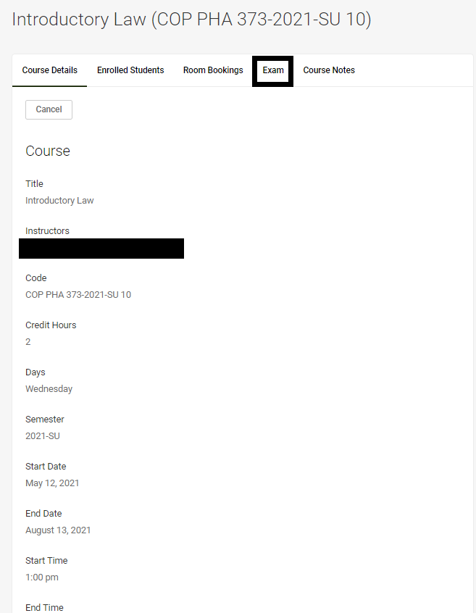
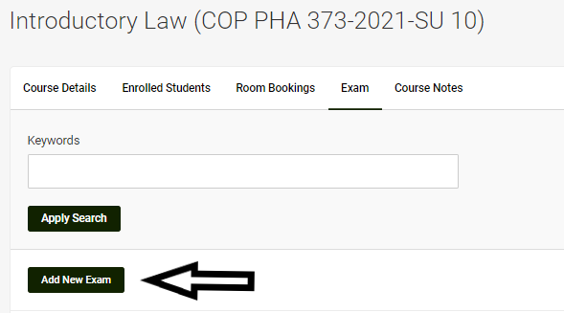
Testing: Upload the exam to the Course
3. Select Exam
4. Add New Exam

Slide 14
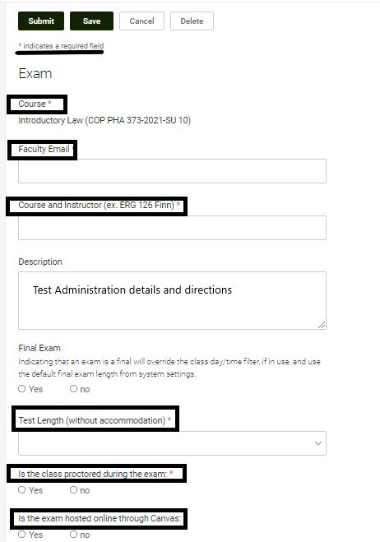
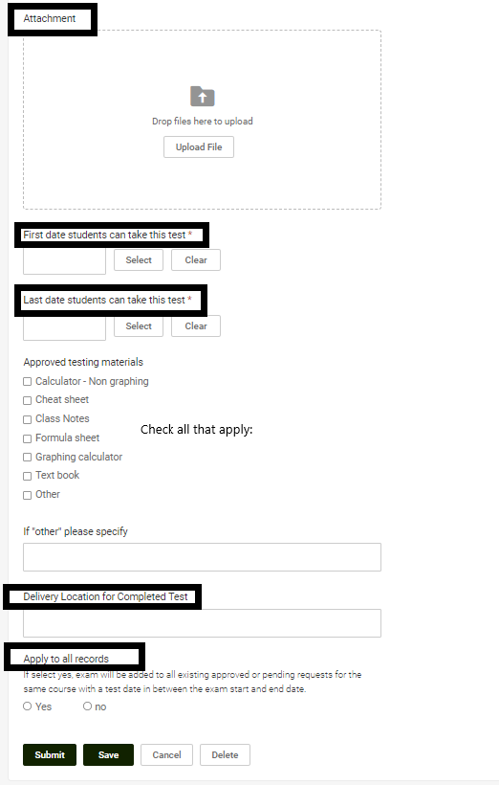
Testing: Upload exam to the Course
5. Fill in the form and Save

