Slide 1
Accommodate Training
for Faculty
How to view and sign
Accommodation Letters

Slide 2
Viewing and Signing Faculty Forms At the Beginning of each semester faculty signs form
To sign Faculty Forms
1. Login to Accommodate
2. Select Accommodations Letters tab
3. Select Access-Faculty Form for the student
4. Once letter is open scroll to the bottom, sign and save

Slide 3
Signing Faculty Forms: Step One 1. Select Accommodation Letters Tab

Slide 4
Signing Faculty Forms: Step Two 2. Select Access-Faculty Form for the student

Slide 5
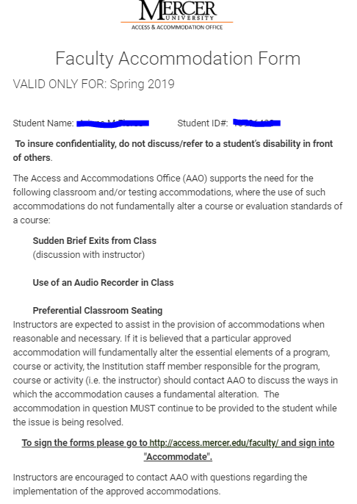
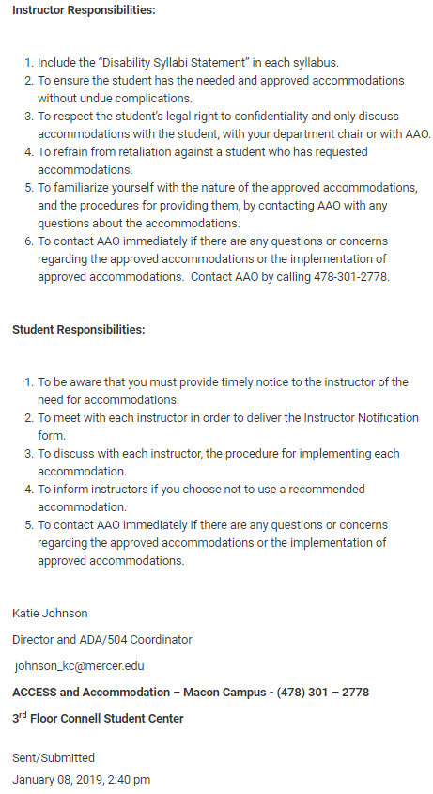
Signing Faculty Form: Step Three 3. Once the letter is open scrAoll to the bottom, sign and save

Slide 6
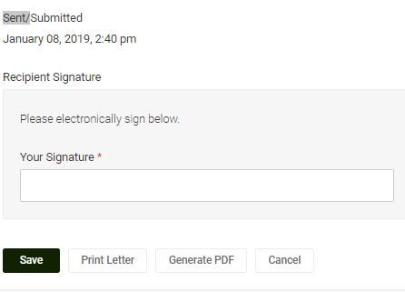
Signing Faculty Forms: Last Step
Sign and Save

Slide 7
Any Questions?
Director
Email: access@mercer.edu
Phone: 478-301-2778
Access Coordinator
Email: access@mercer.edu
Phone: 478-301-2529

